Slide 1
Microelectronics III
Design of integrated analog and mixed-signal
CMOS-Circuits
Chihao Xu

Slide 2
Advantages of digital circuit technology
Simple and faultless processing possible,
so that large complexity can be managed.
Low requirements on variation in production
Design
Effort
Analog
Digital
Complexity
Digital means discrete value (binary) and discrete time !
High resolution is achieved by several bits (parallel)
and clocks (sequential).

Slide 3
Why analog and mixed-signal?
  Interface-circuits
    Amplification
    Filtering
    Modulation/Demodulation
    Analog/Digital-Conversion
    Digital/Analog-Conversion
  Signal processing
    Simple functions
    Quick feedback control
Clock generator
    Oscillator

Slide 4
Technical System
Actuators
Sensors
Analog Shell
Control
A/D
D/A
Logics
Processor /
Algorithm
Memory
Logics
I/O Interface
Digital Core
Programs
Human-Machine-Interface

Slide 5
Success Factors in Microelectronics
Process CAD Design
Analog
20%
10%
70%
Digital
33%
33%
33%
Strength of European chip industry

Slide 6
Different operation region of analog vs. digital
Analog technology
Inverter
Inverter characteristic
Digital technology

Slide 7
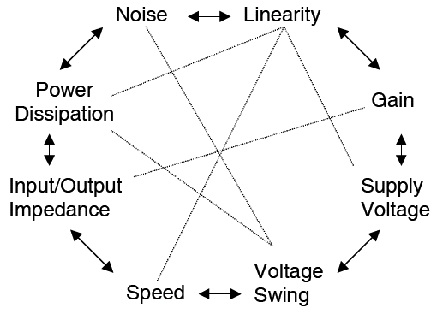
Parameters to be considered in Analog Design

Slide 8
Bipolar Circuit Technology
Bipolar-Process: only slow development
Is used for
- High frequency ICs (bipolar with Ge faster than CMOS)
Application: Network-IC with BiCMOS
- High blocking voltage (bipolar injection reduces voltage-drop)
Application: Power electronics for high output power
(Low volume compared with lower blocking voltage)
- High precision
Bipolar transistor is more robust (low variations in manufacturing,
insensitive to mechanical stress etc.).
Application: Operational amplifier
Bipolar technology is mainly for „niche“ applications.

Slide 9
Analog MOS-Circuit Technology
Enormous synergy effects to digital technology (Process-Development)
Simple Integration with digital circuits possible
(e.g. as analog Frontend System on a Chip)
☺ High input impedance
☺ Frequency increases with newer process
☹ In modern processes the operating voltage gets lower.
Fields of Circuit Technology
- Analog-Digital-Converter (ADC) and Digital-Analog-Converter (DAC)
RF IC ( few GHz-range)
HV IC (< 100 V for Automobile, Display, Power Management, Industry etc.)
Low Voltage Design
Low Power analog circuits
Often 99% of transistors are digital and 1% analog.
But this 1% makes the difference.

Slide 10
Content
    Introduction into Analog Circuitry
    CMOS Circuit Components
      Devices, inverter, source-follower, active load, current sources, cascode, differential stage
    Operational Amplifier
      Structure , frequency compensation, optimal layout, characteristic parameters
    Bandgap Reference
    Switch-Capacitor-Technique
    Analog/Digital-Converter
    Digital/Analog-Converter
    Phase Locked Loop (PLL)
Mixed-Signal

Slide 11
References
    B. Razavi, Design of Analog CMOS Intergated Circuits, McGraw-Hill, 2001
    P. E. Allen and D. R. Holberg, CMOS Analog Circuit Design, Oxford University Press, 2002.
    D. Johns, K. Martin, Analog Integrated Circuit Design, John Wiley & Sons, 1984, 1997
    P. R. Gray and R. G. Meyer, Analysis and Design of Analog Integrated Circuits, John Wiley & Sons, 1984.
    U. Tietze, C. Schenk, Halbleiter Schaltungtechnik, Springer, 1990

Slide 12
Introduction in Analog Technology:
P
W
[ ]
f
Hz
10
-9
Process
Development
10
-12
-15
Power vs. Signal to Noise S/N
10
Analog
10
-18
Digital
S
N
[dB]
30
60
90
120

Slide 13
Comparison of Analog-Digital
Analog:
Digital:
α: Activity factor
CMOS process optimized for digital circuits
High functional density
  --> small chip size
CAD/EDA mainly for digital circuits
No truncation and limitation
Complex algorithms
possible
Interfaces to real world
Insensitive to noise

Slide 14
Dual Slope Converter for Digital-Voltmeter
U
in
U
U
i
Ref
K
Controller +
Counter
Clock
Display
DW
Register

Slide 15
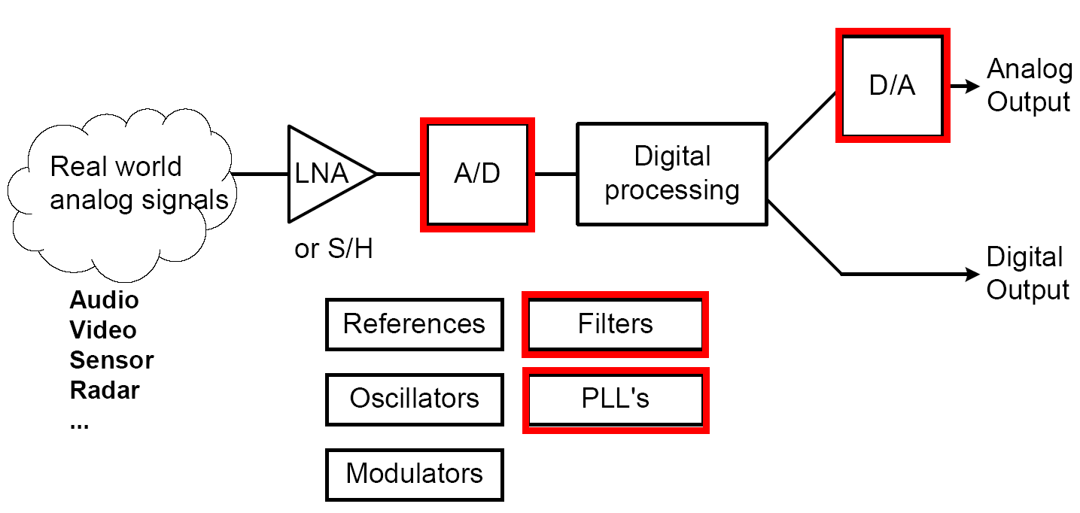
Typical Signal Processing
Low Noise Amplifier
Mixed-Signal Circuits
Digital Circuits

Slide 16
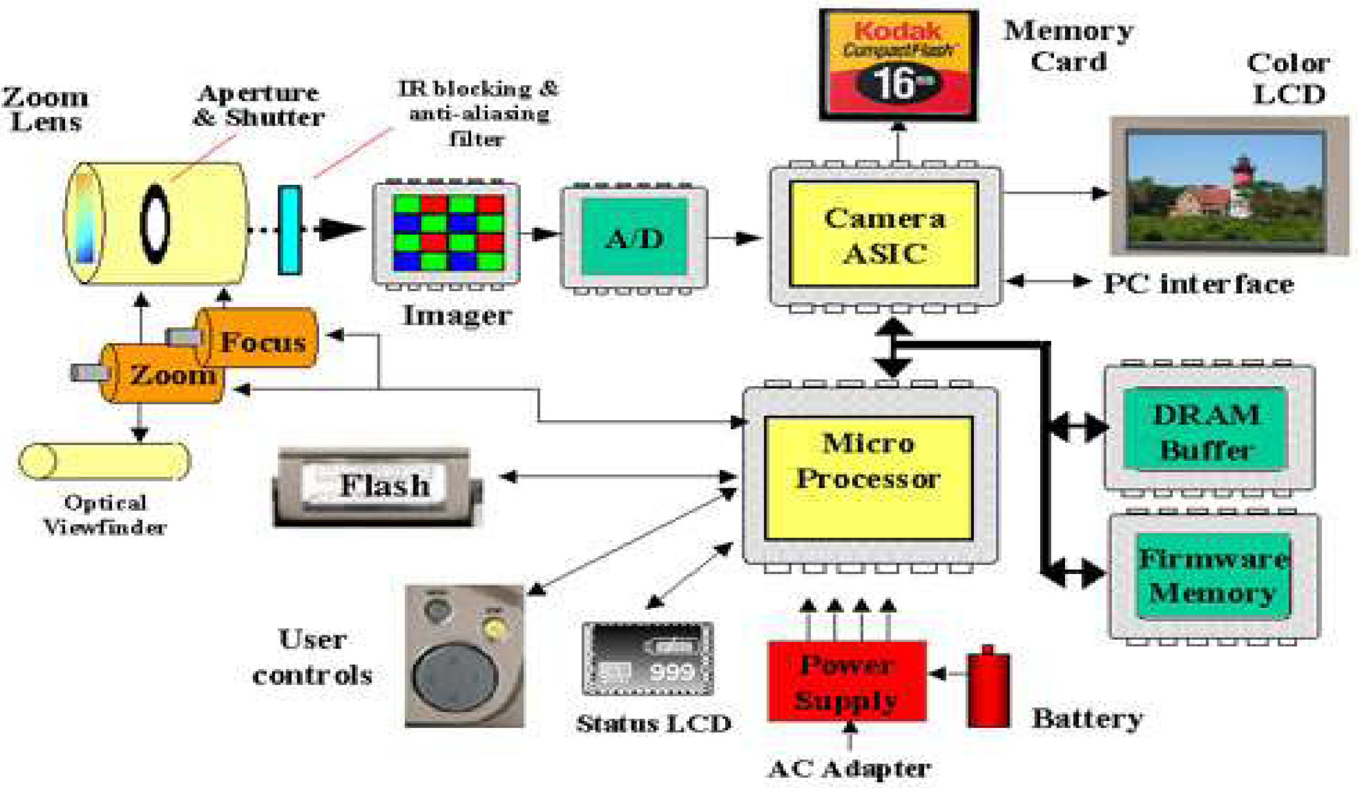
Example: Architecture of a Digital Camera
DA-Converter
+ Driver
Sensor + Readout
AD-Converter
Signal-
Processing
Camera-Chip

Slide 17
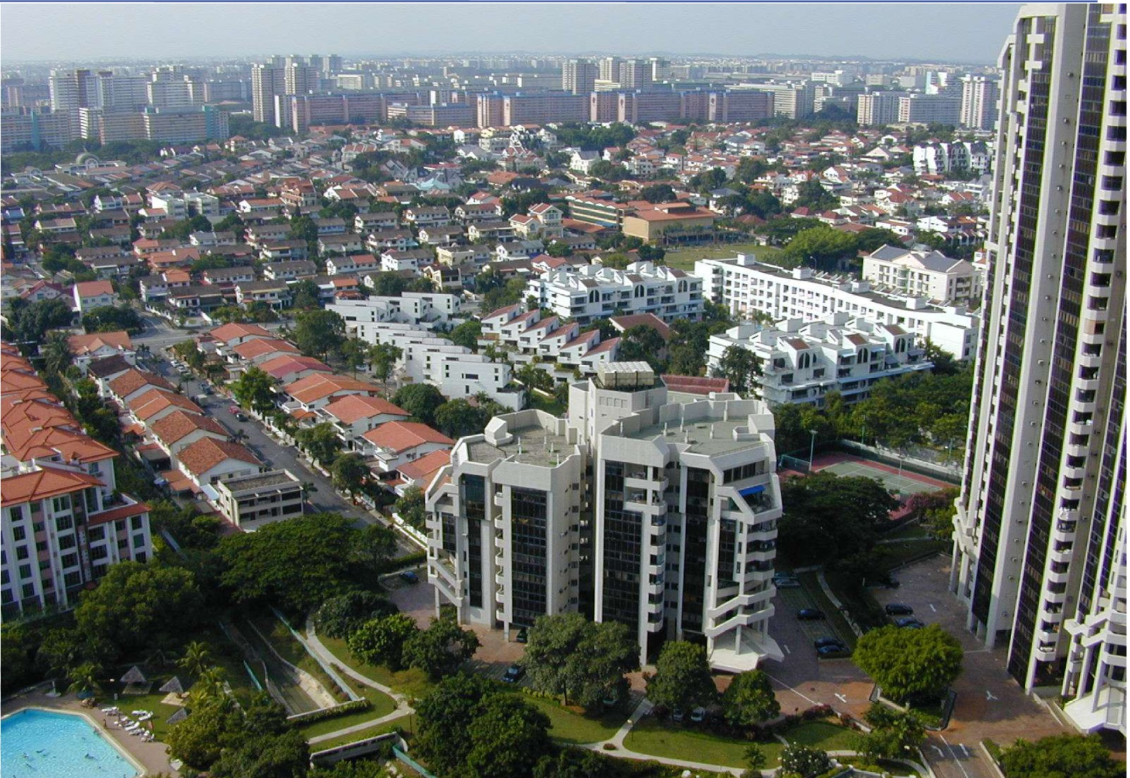
Optical Distortion (Barrel-Effect)

Slide 18
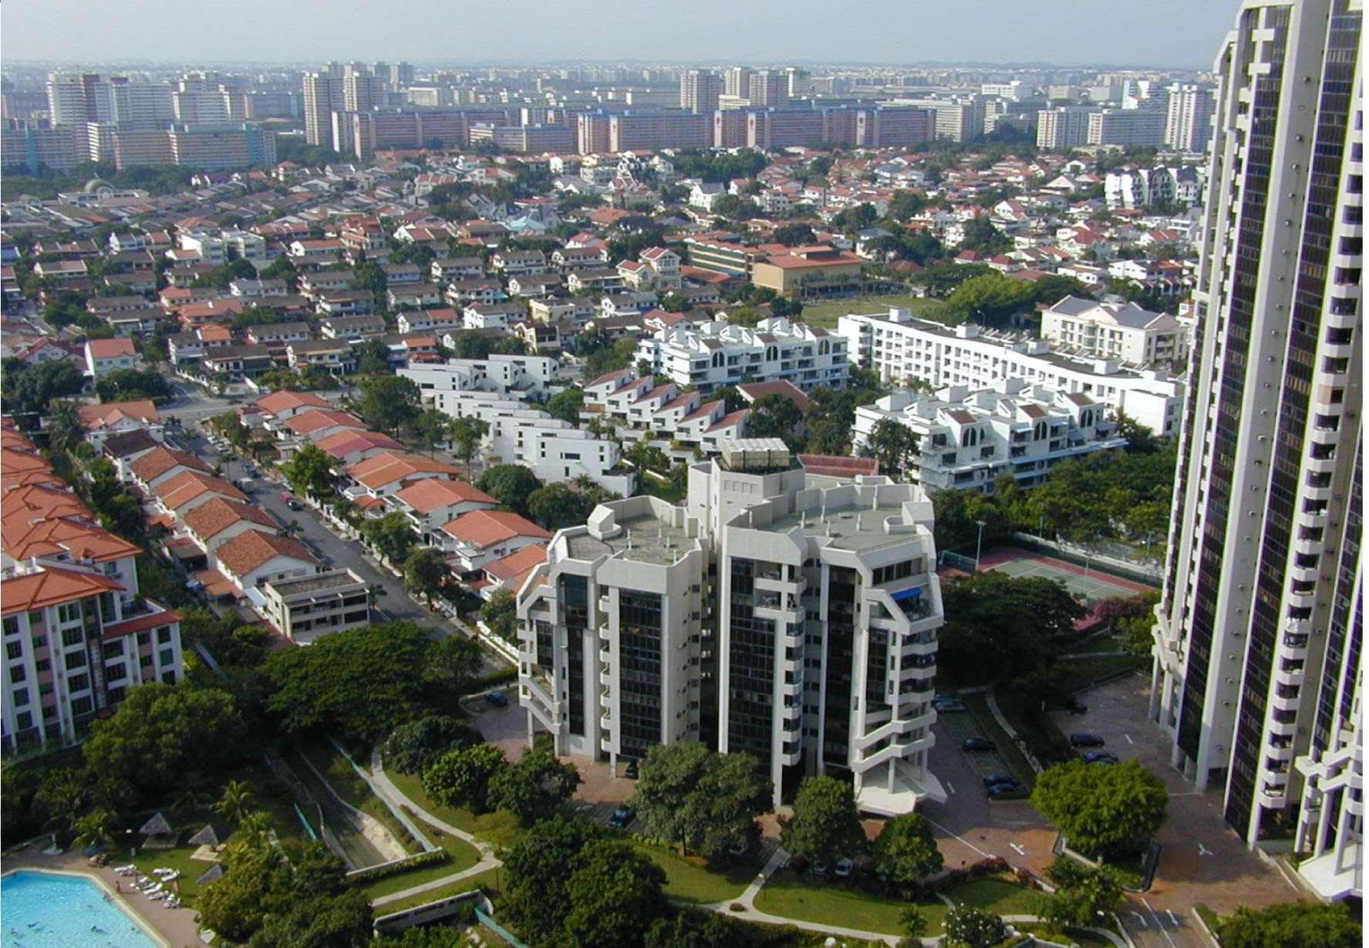
Correction of Optical Distortion (Digital Image Processing)

Slide 19
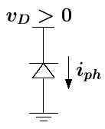
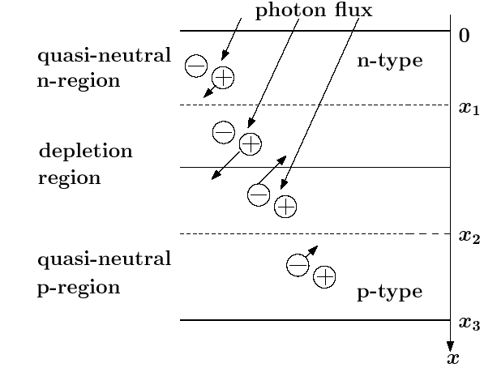
Photo-Detector: Diode
Al (contact)
- U_{D} +
p-Sub
n+
p+
Depletion

Slide 20
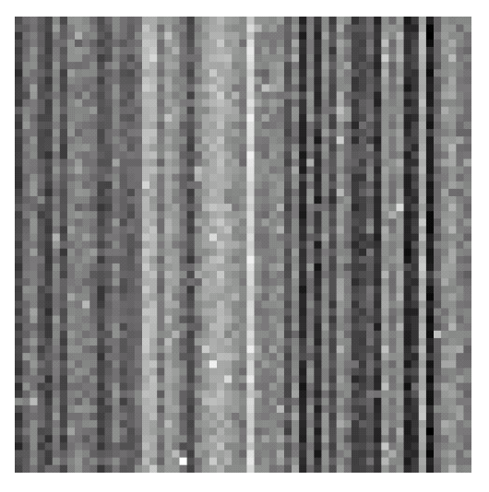
Quality features of a Photo-Detector
Dark Current: if there is no light
Temperature Noise
Fixed Pattern Noise: non-uniformity for dark signals,
but may get visible in photos.

Slide 21
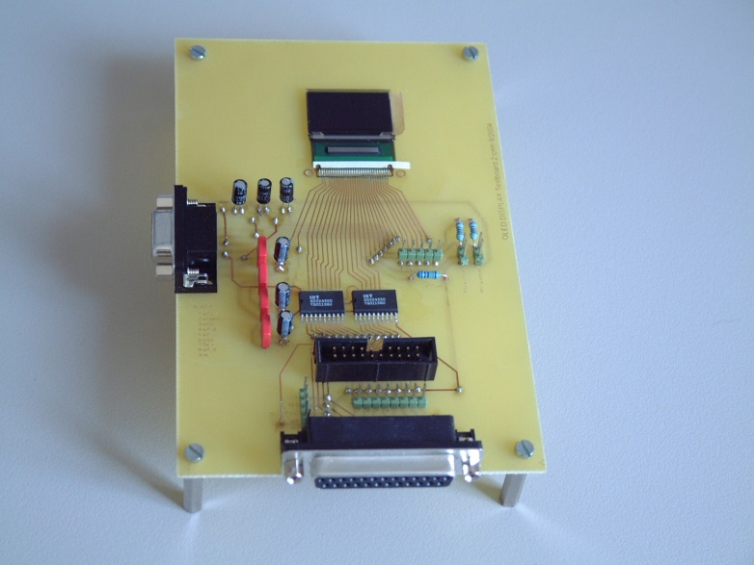
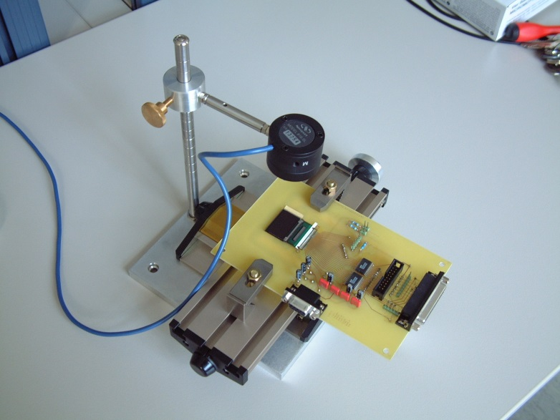
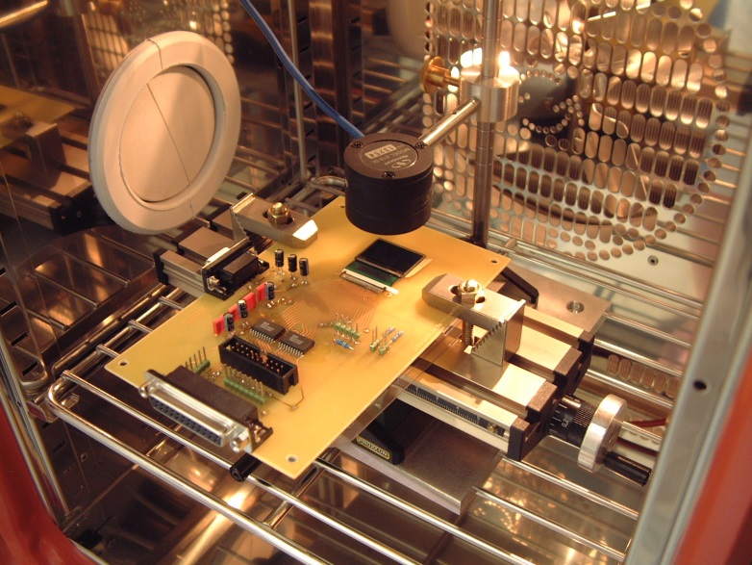
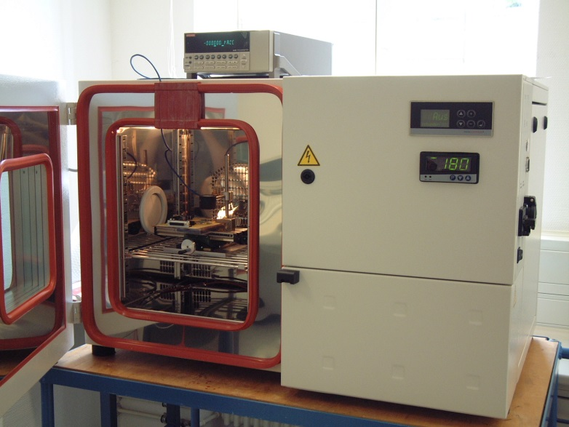
Optical Characterization of Displays
Display
Photo-Detector
Ampere meter
Temperature
Dark chamber

Slide 22
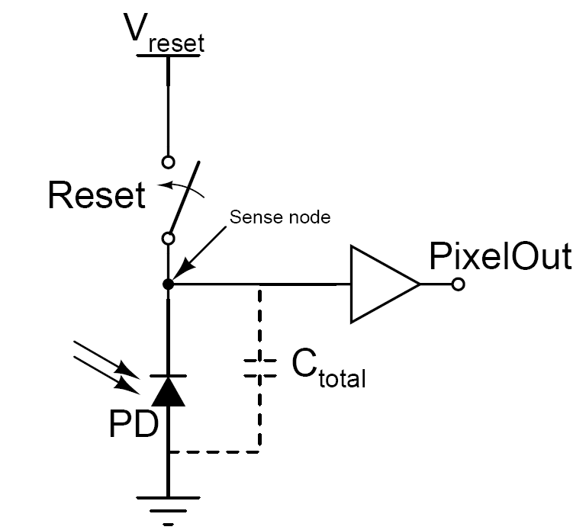
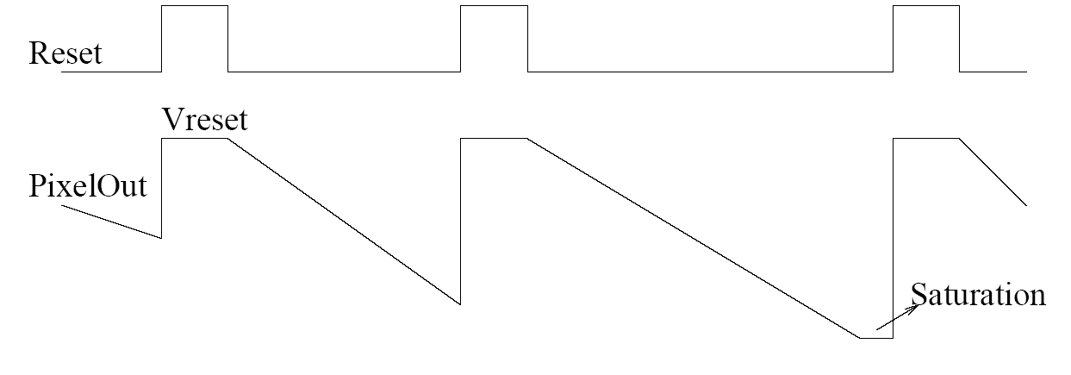
Readout Circuit of Photodiode (Pixel)
exposure
time
Functions of readout circuit
Light
-> Current
-> Charge
-> Voltage

Slide 23
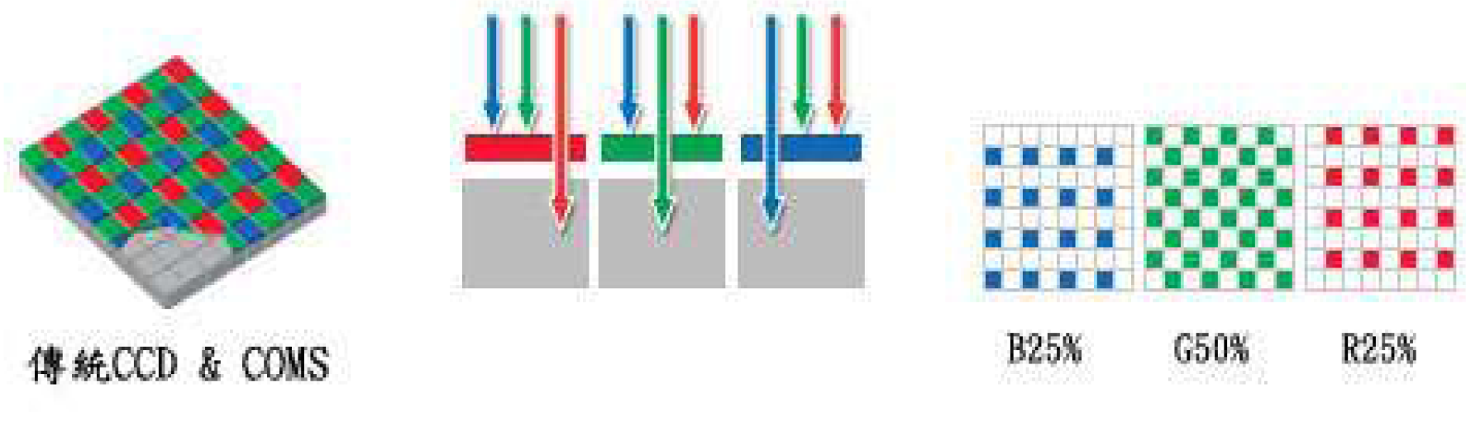
How are colors sensed ?
Color filter: RGB

Slide 24
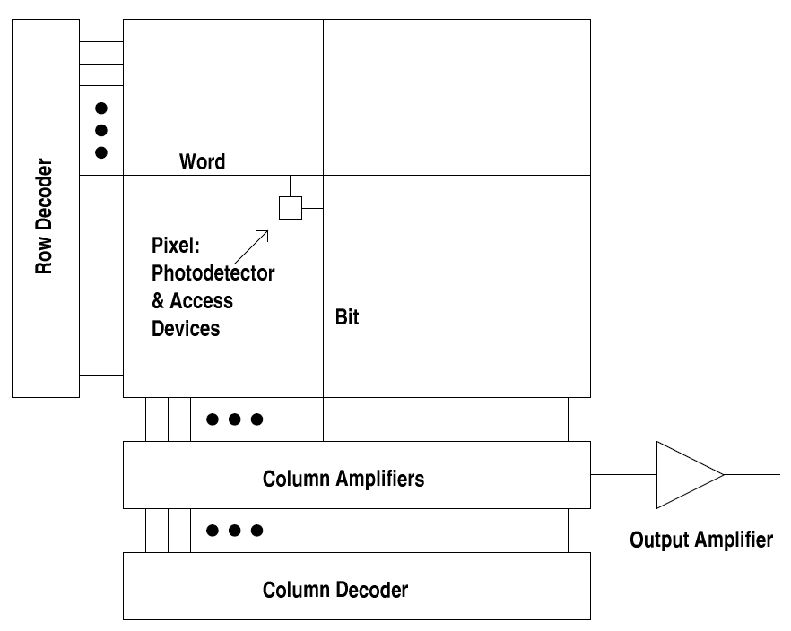
Pixel-Array
A pixel consists of a sensor and the readout circuit.

Slide 25
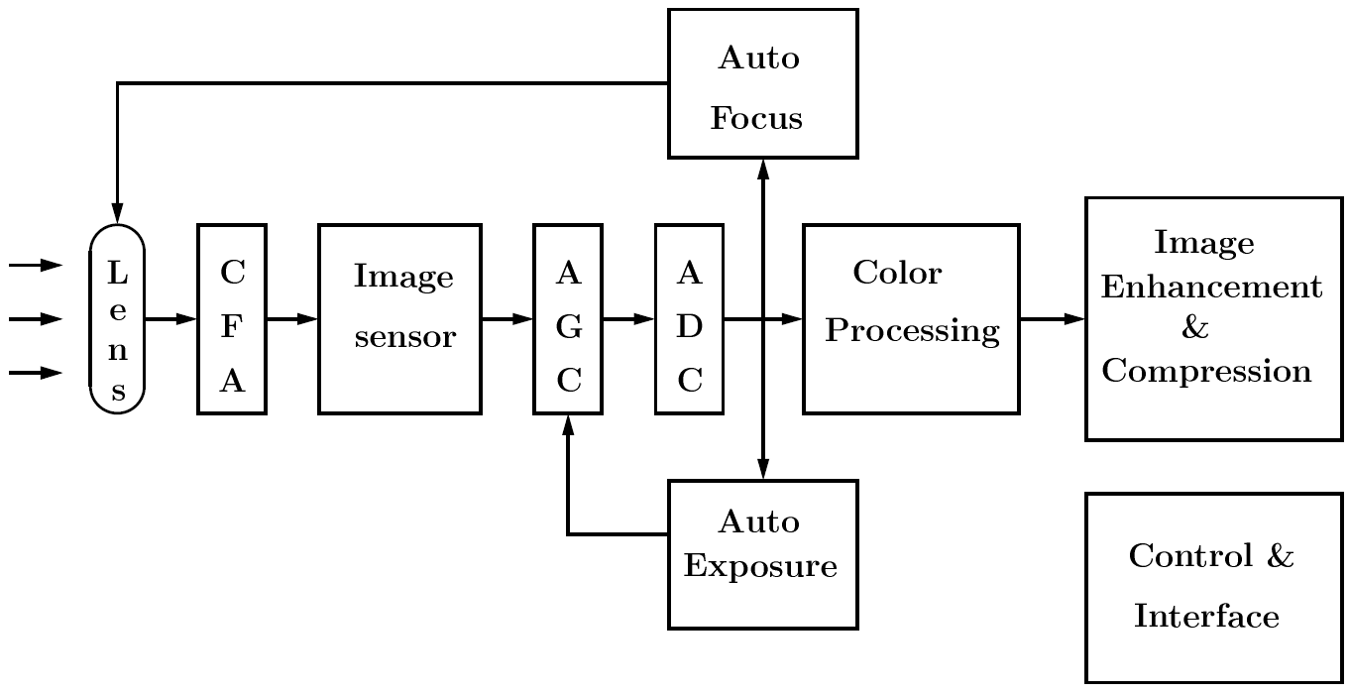
Structure of a Digital Camera
CFA: color filter array
AGC: automatic gain control
AD-Converter: low power, high speed
Quality features: dark current dynamic range
flexible, adapted
dark  bright

Slide 26
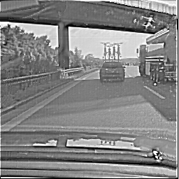
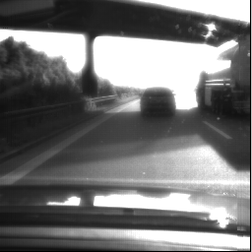
High dynamic range CMOS vs. CCD´s
Multi-Integration
Recalculated image of a 256x256
Pixel CMOS - image Sensor using
4 different integration times
Conventional CCD sensor
CMOS has a higher dynamic range (ca. 1000), while CCD just about 100 (analog).
How can the details be displayed? Compression of contrast (digital)

Slide 27
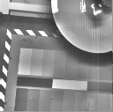

High dynamic range CMOS vs. CCD´s
Local Brightness-Adaptation
128x128 Pixel CMOS Sensor
using a 9x9 rect - Filter Kernel
768x576 CCD sensor

Slide 28
Special Challenges for Digital Camera
Pixel-Design
Photo-Detector Design
Sensitive Readout-Circuit
⇨ Exposure in the darkness
⇨ High contrast
Furthermore: Low Power / fast ADConverter
Analog Mixed-Signal Design is the key to success !

